Slide 1
Лекция 9
Контейнеры и итераторы
Программирование на языке C++
Константин Леладзе
ФКН ВШЭ

Slide 2
Containers
A container is an object used to store other objects and taking care of the management of the memory used by the objects it contains.
An allocator aware container is a container that holds an instance of an allocator and uses that instance in all its member functions to allocate and deallocate memory and to construct and destroy objects in that memory (such objects may be container elements, nodes, or, for unordered containers, bucket arrays).
Container types:
Sequence containers:
array
vector
list
forward_list
deque
Associative containers:
set
map
multiset
multimap
Unordered associative containers:
unordered_set
unordered_map
unordered_multiset
unordered_multimap
Adaptors:
stack
queue
priority_queue

Slide 3
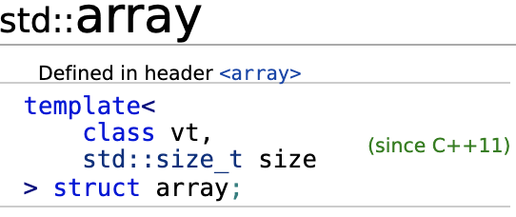
Array
std::array is a container that encapsulates fixed size arrays.
std::array is not an allocator aware container, it doesn’t allocate or deallocate memory on heap.
std::array is a template class which has to be provided with the type of the underlying elements and the number, indicating the needed size of the array.

Slide 4
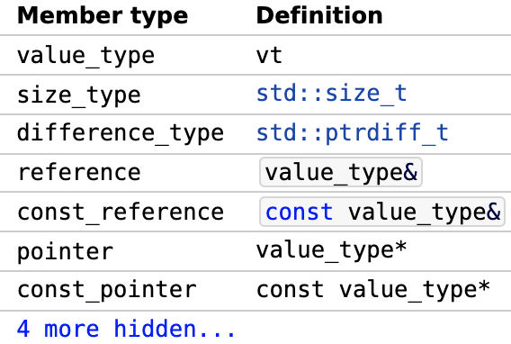
Array
Member types:
value_type: the type of the values stored inside the array. It is useful to obtain the type of underlying element when it is not known beforehand
size_type: the type of the indicies used to obtain elements. The value of this type is returned from the size method (described on the next slide) and received in the operator[]
difference_type: indicates the type of the difference between pointers to values. This type is rarely used, in most containers it is similar to std::iterator_traits<pointer_type>::difference_type, which in the case of std::array is std::ptrdiff_t
reference, const_reference, pointer, const_pointer: these typedefs are helpers, defined for the convenience

Slide 5
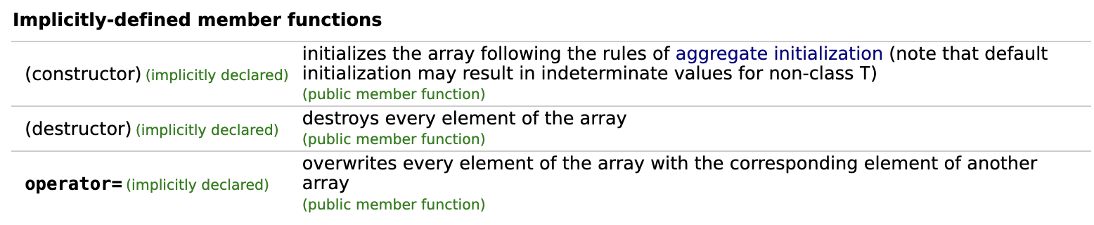
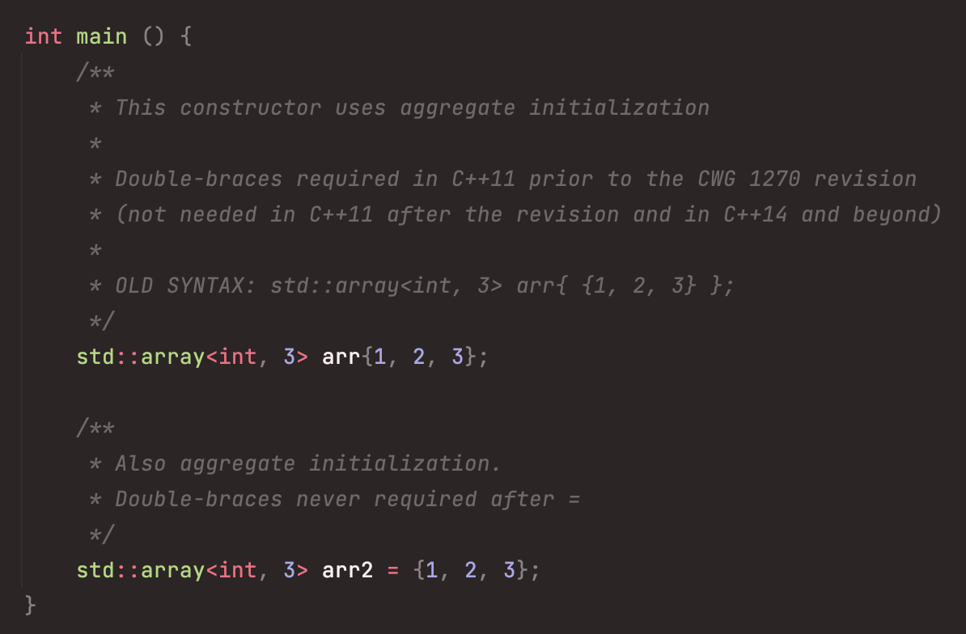
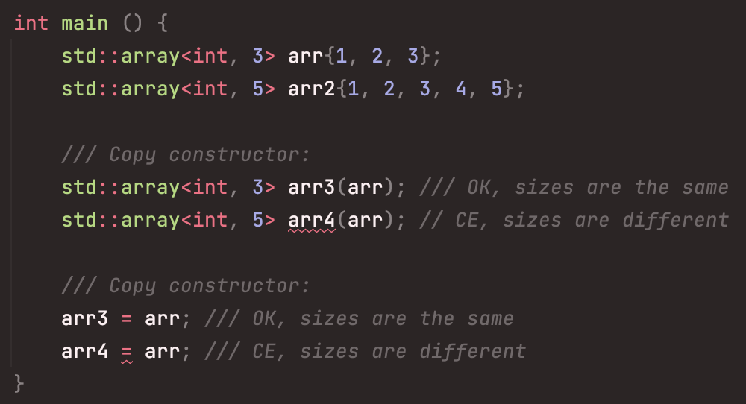
Array
Constructors, destructor and assignment operator:
Copy constructor and copy assignment operator will produce CE if the sizes of the two arrays are not equal:
Example 1
Example 2

Slide 6
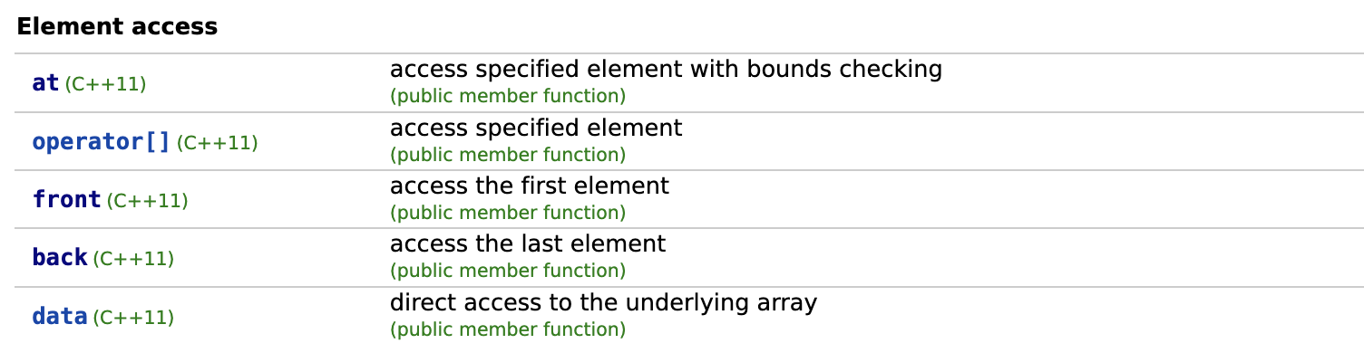
Array
at: returns a reference to the element at the given index. std::out_of_range exception is thrown if the index is out of the array’s bounds.
operator[]: same as the at method, but no exception is thrown if index is incorrect. Thus, if you provide incorrect index to this operator, an UB happens.
front: similar to the arr[0]
back: similar to the arr[arr.size() - 1]
data: returns a raw (C-style) pointer to the first element in the array. The elements are guaranteed to be contiguous, so you can use the pointer to iterate over the array, however it’s not recommended to use this method due to its low-level nature.
All of the methods, listed above have both const and non-const qualified versions. In the case of const-qualified version, every method acts like a getter, returning const_reference, in the opposite – like a getter and a setter simultaneosly (i.e. accessor), returning reference.
Let’s now look at the Example 3.

Slide 7
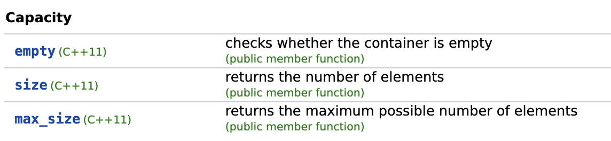
Array
empty: returns a bool value, indicating if the array is empty or not
size: returns the number of the elements (provided as a non-type template parameter).
max_size: return the same value as size (in the case of std::array, for the other containers the behavior is different)
Both size and max_size methods return size_type value.
Let’s now look at the Example 4.

Slide 8
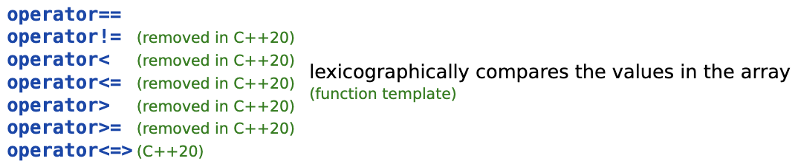
Array
operator== and operator!= compares arrays element-wise by applying operator== to the each respective pair of elements. So, if you want to use operator== on the array of some type, this type should be comparable, meaning that the operator== should be defined for it.
Other operators compare the arrays lexicographically. Comparison is performed with the function, similar to std::lexicographical_compare
Since the C++20, all comparison operators except operator== were removed and replaced with the three-way comparison operator. We’ll talk about it later in the lesson which we’ll cover C++20 in.
Let’s now look at the Example 5.

Slide 9
Range-based for loop

Slide 10
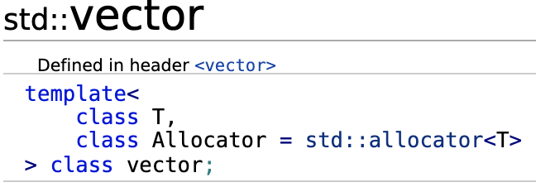
Vector
You should be already familiar with this container, because we have used it before.
std::vector is a sequence container that encapsulates dynamic size arrays. Remember, you can append an element with the push_back method, which is not supported in the case of std::array.
std::vector is an allocator aware container, it allocates and deallocates memory on heap and manages it dynamically. By default, the std::allocator<vt> is used for std::vector<vt> class, but you of course may want to use a custom allocator, so you can provide it’s type as a second template parameter.

Slide 11
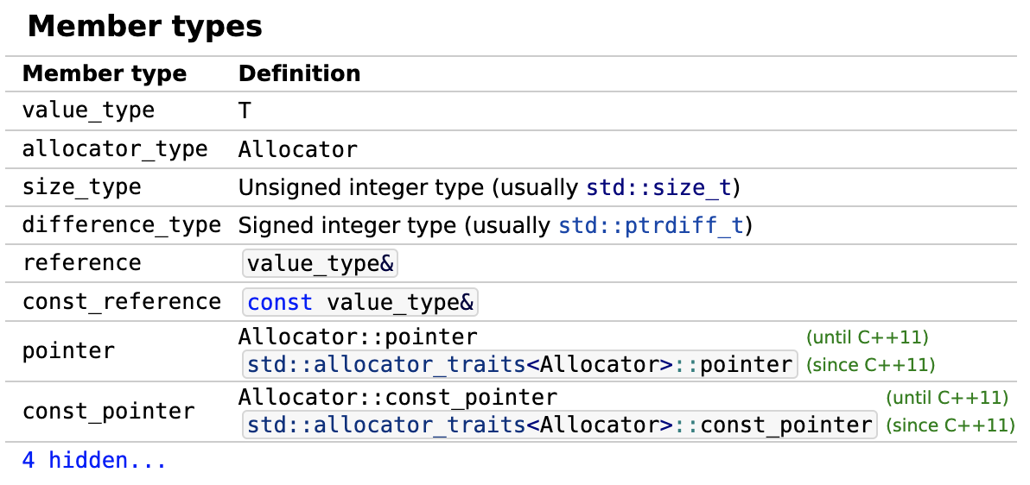
Vector
As you can see, the std::vector class has the same typedefs as the std::array class. Furthermore, all of the defined types are common for the containers. Almost all of them has these types defined, which allows us to create a generalized template functions, receiving a polymorphic container and using its typedefs in order to work with proper types. Let’s now at an example of such function in the Example 7.

Slide 12
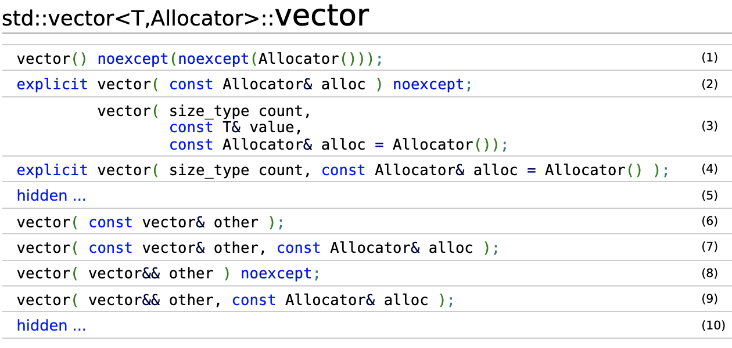
Vector
Constructors:

Slide 13
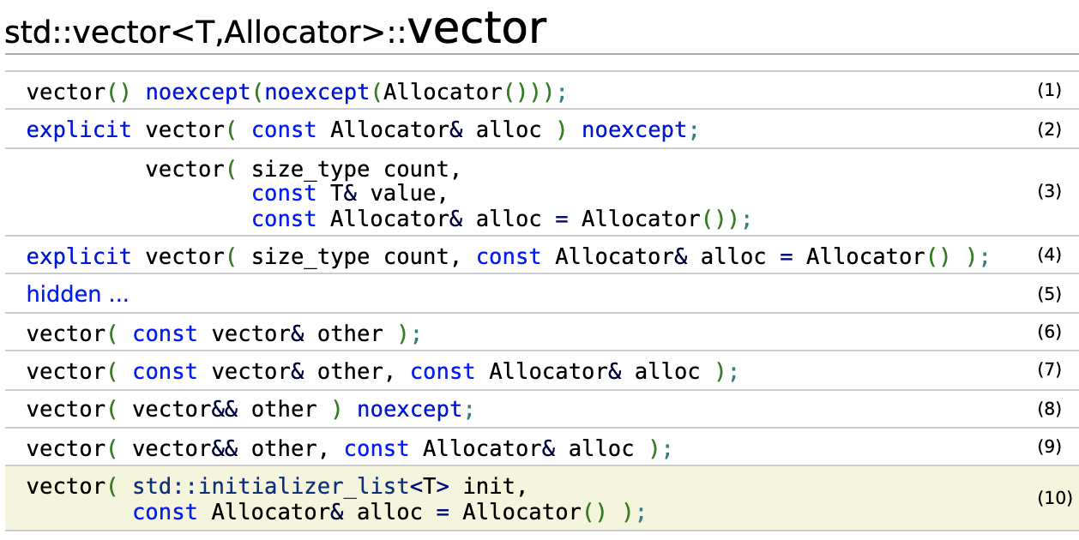

Vector
std::vector is a sequence container that encapsulates dynamic size arrays.
std::vector is an allocator aware container, it allocates and deallocates memory on heap and manages it dynamically.
Constructors:
Destructor:

Slide 14
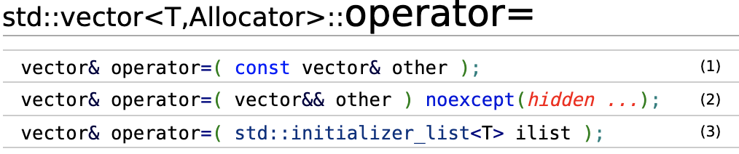
Vector
std::vector is a sequence container that encapsulates dynamic size arrays.
std::vector is an allocator aware container, it allocates and deallocates memory on heap and manages it dynamically.
Assignment operators:

Slide 15
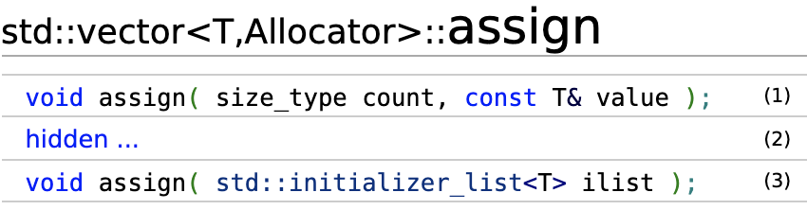
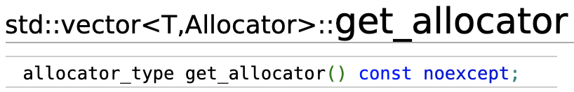
Vector
std::vector is a sequence container that encapsulates dynamic size arrays.
std::vector is an allocator aware container, it allocates and deallocates memory on heap and manages it dynamically.
Other member methods:

Slide 16
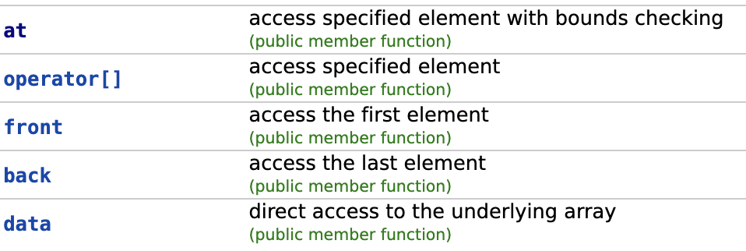
Vector
std::vector is a sequence container that encapsulates dynamic size arrays.
std::vector is an allocator aware container, it allocates and deallocates memory on heap and manages it dynamically.
Element access:

Slide 17
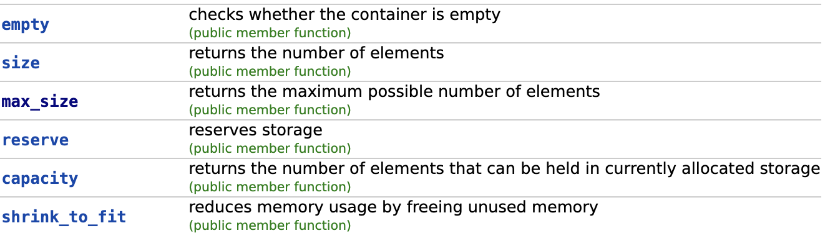
Vector
std::vector is a sequence container that encapsulates dynamic size arrays.
std::vector is an allocator aware container, it allocates and deallocates memory on heap and manages it dynamically.
Capacity:

Slide 18
Range based for loop

Slide 19
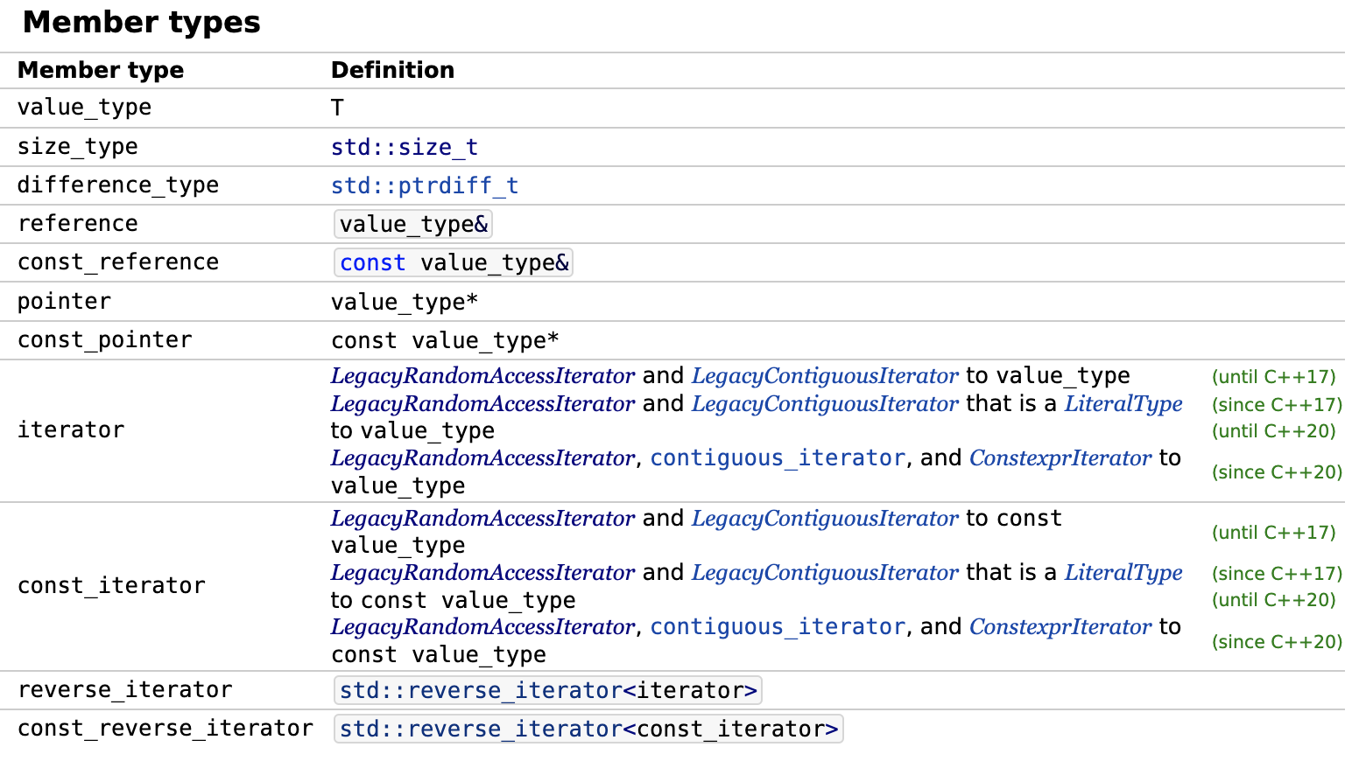
Iterator
Remember 4 hidden member types? Let’s have a look on them:

Slide 20
Iterator
Iterator is a certain analogue of a pointer. Actually, this analogy is not completely correct, because the majority of iterator types prohibit some operations allowed by the pointer.
Iterator is an internal public struct defined in all of the containers (except adaptors). You can easily access it by using the scope resolution operator, for example: vector<int>::iterator.
Every container (except adaptors) has special methods which allow to obtain the iterator to the first element in the container (method begin) and the imaginary element after the last one (method end).
Every iterator has a category. For example, std::array<…>::iterator is a contiguous iterator.
Iterator can be const or reverse.
So, we can conclude that an iterator is a higher-level entity, a wrapper of pointers, which provides a more convinient way to work with data and restricts some operations.

Slide 21
Iterator
Let’s look at the 6 iterator categories:
Iterator
Input iterator
Output iterator
Forward iterator
Only for non-const iterators
Bidirectional iterator
Random access iterator
Contiguous iterator

Slide 22
Лекция 9
Контейнеры и итераторы
Программирование на языке C++
Константин Леладзе
ФКН ВШЭ

